Slide 1
Boosting

Slide 2
Random forest focuses on multiple trees that builds parallelly. It does not take into account the error made by previous tree,
Trees does not have relations with each other.
Each individual tree do not learn from each other trees.
To improve the performance can we learn the mistakes from previous model.
For that we use boosting..

Slide 3
In boosting
Models are dependent
Correct the errors of previous models
Models Build Sequentially
Each subsequent model attempts to correct the errors of previous model.
Succeeding models are dependent on previous model.

Slide 4
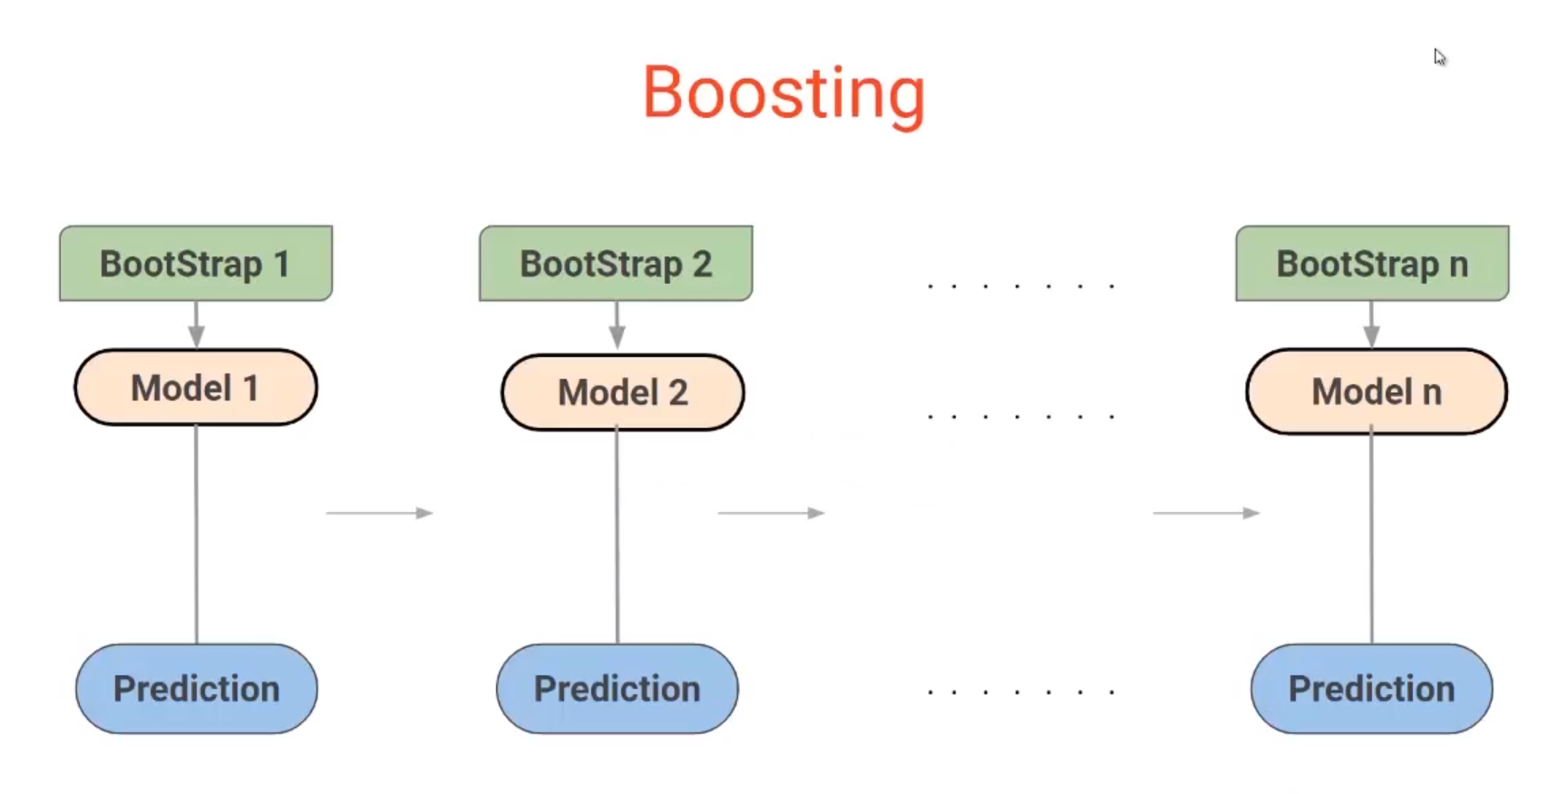

Slide 5
Stopping criteria for Boosting
Till errors become zero
There is condition on number of models.

Slide 6
Gradient Boost (Gradient Boost Machine)
Models are build sequentially
Each model try to reduce the errors of previous models. How?
By building the model on the errors or residuals of previous predictions.
This is used to determine any patterns in the error missed by previous models
Lets see an example……

Slide 7
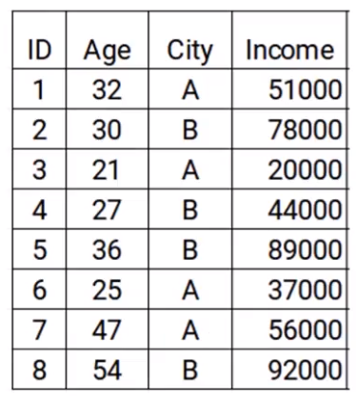
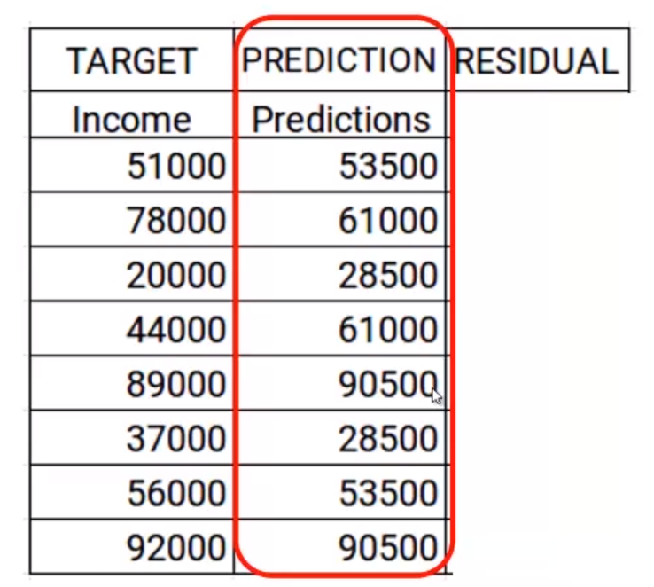
Eg.
Step 1. Build the model and make a prediction on given data.

Slide 8
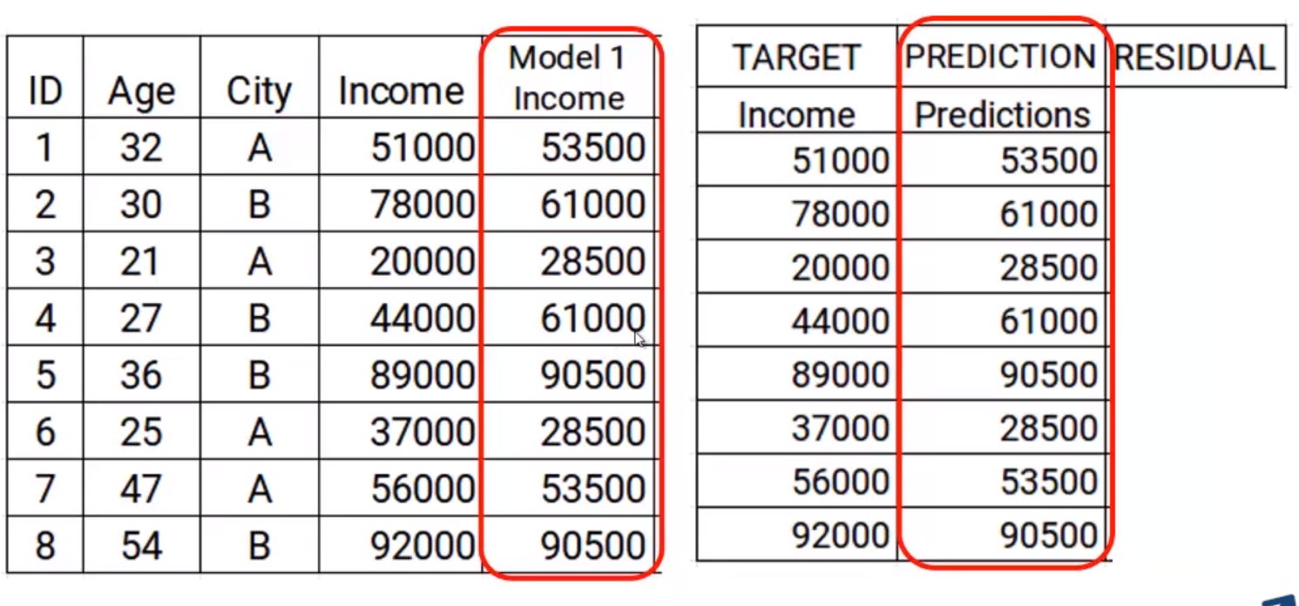
Lets update the data. Add new col i.e prediction in dataset

Slide 9
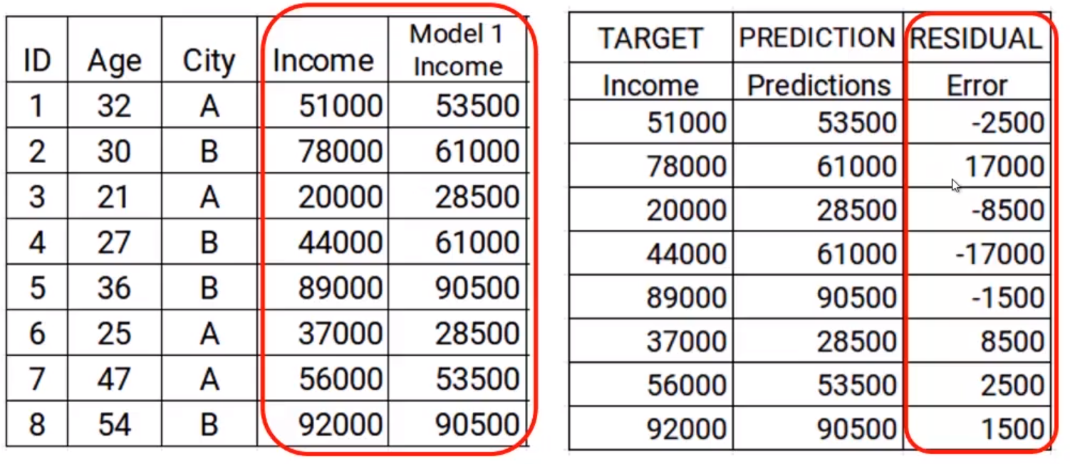
Step 2: Calculate the error in last model and set it as a target because this algo mainly focus on error

Slide 10
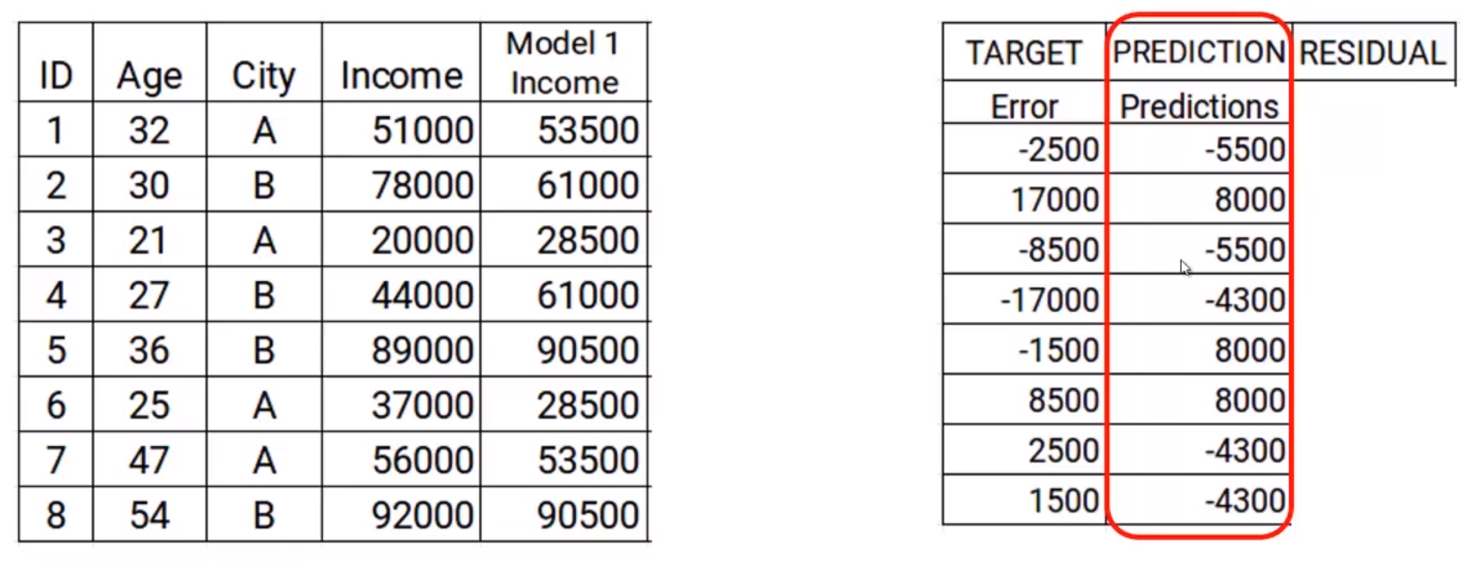
Step3: Build the model on error and make a prediction
Error is target and age and city is independent variables. Just check Prediction is similar to errors as we build the model on error

Slide 11
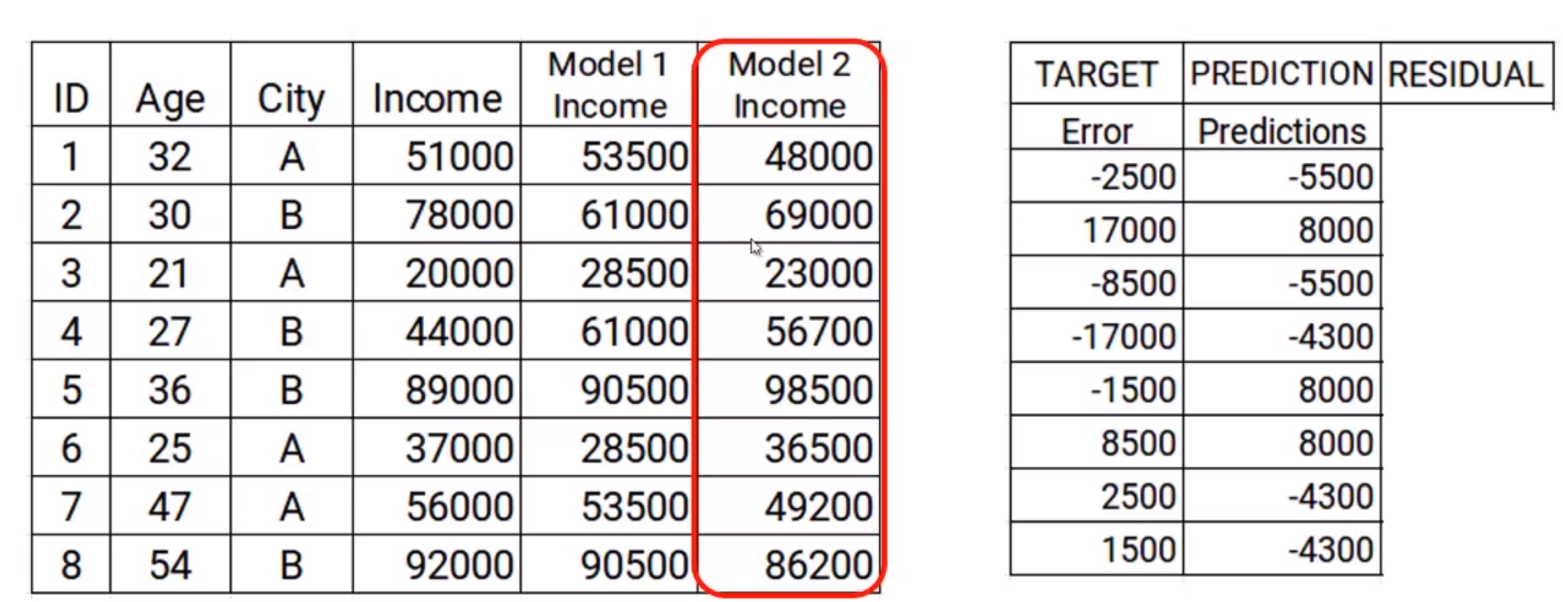
Step 4: Update the predictions of model 1
We add new prediction with previous one. Model2=model 1+new prediction.
We can see model 2 predictions are closer to income col i.e actual values

Slide 12
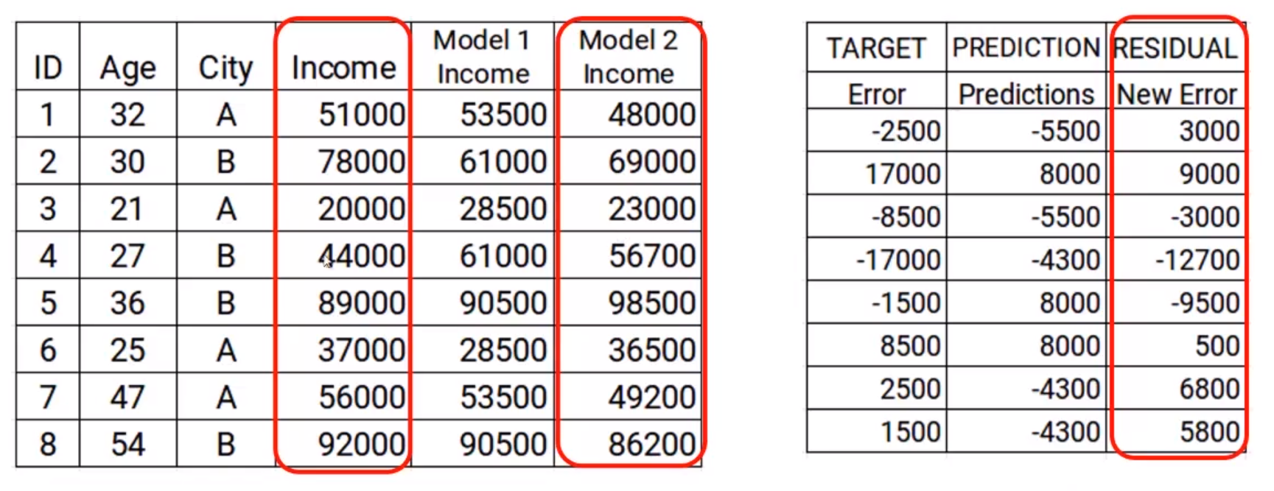
New errors will be

Slide 13
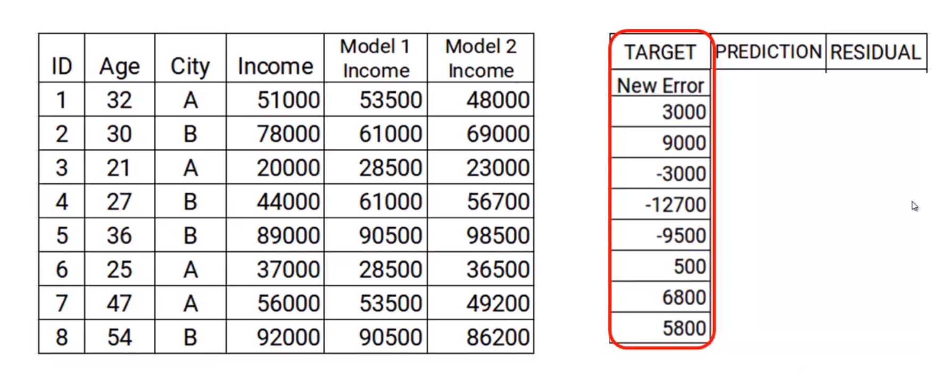
This new error will be our new target variable.
We repeat the steps again and again….till error near to zero.

Slide 14
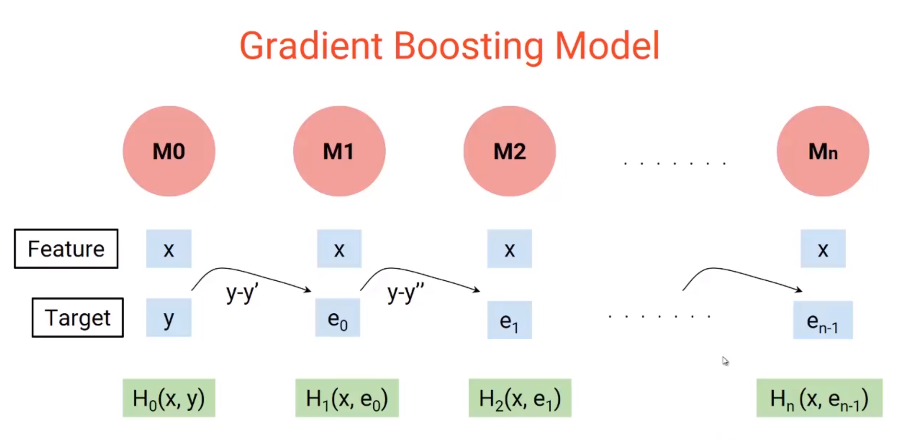

Slide 15
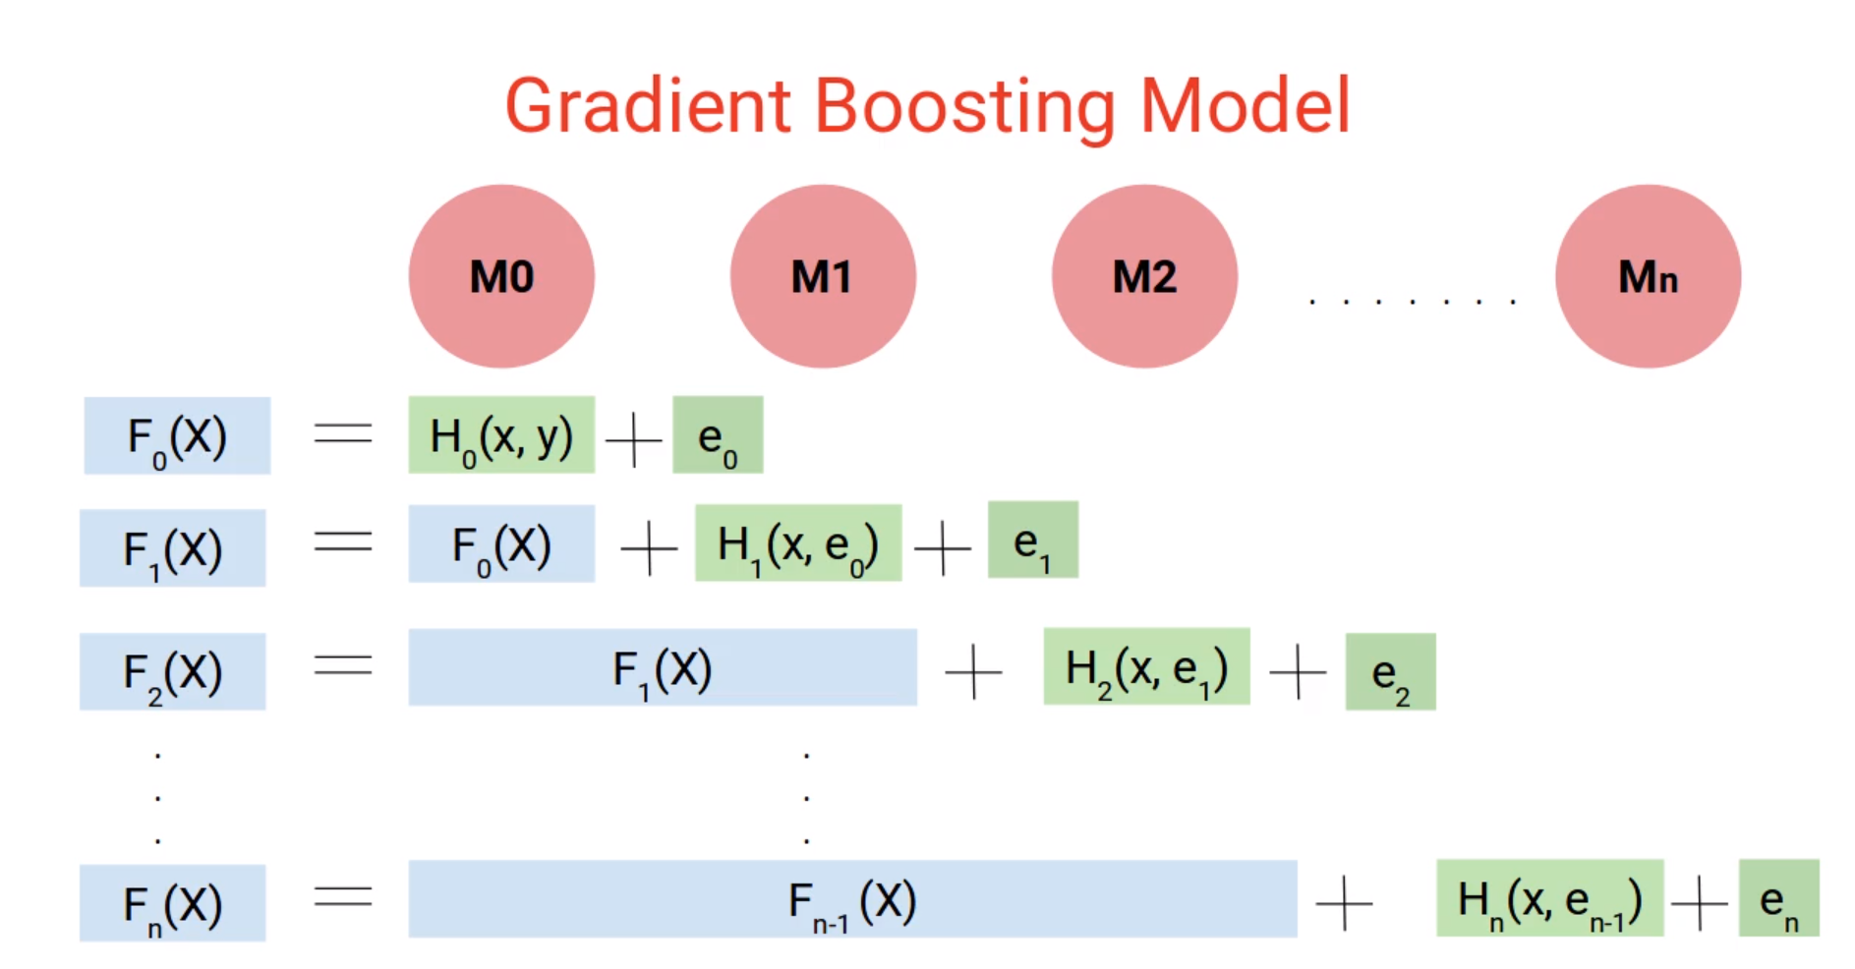

Slide 16
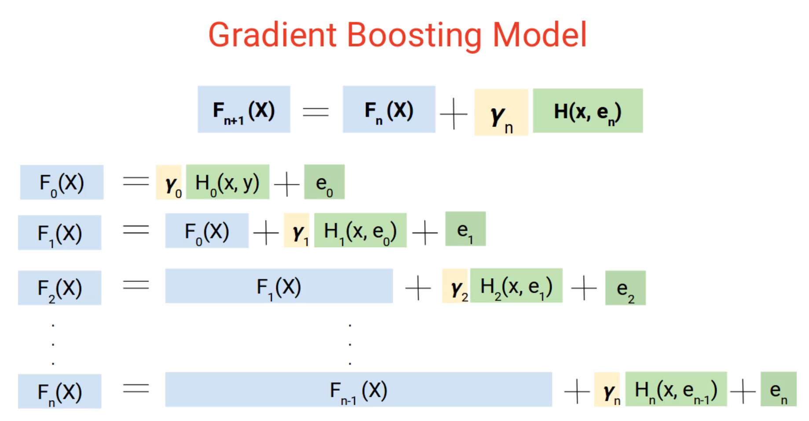

Slide 17
XGBOOST
Extreme Gradient Boosting Machine
Same as GBM
Designed for speed and performance

Slide 18
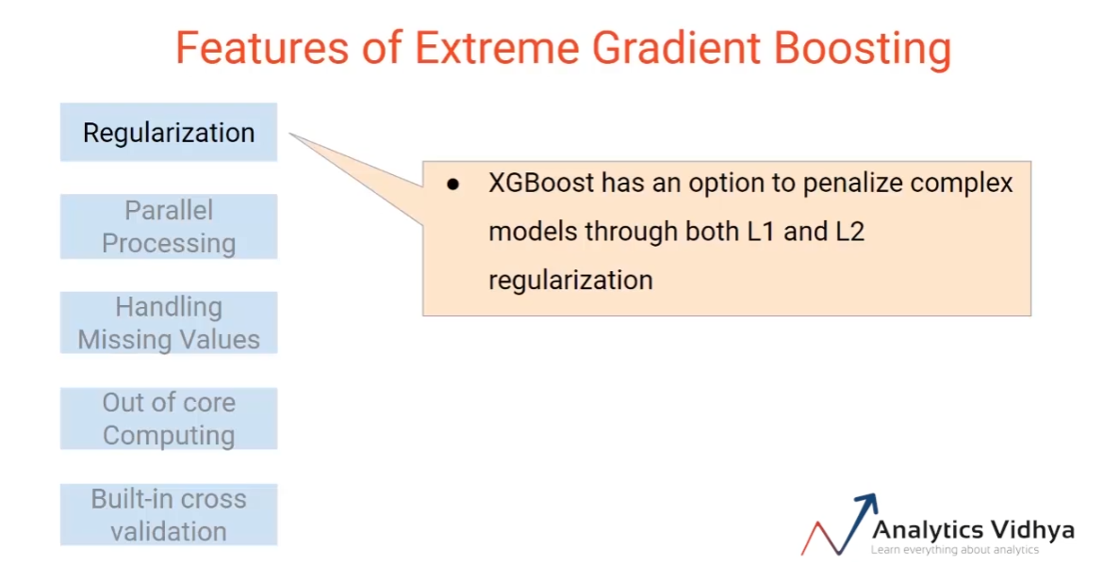

Slide 19
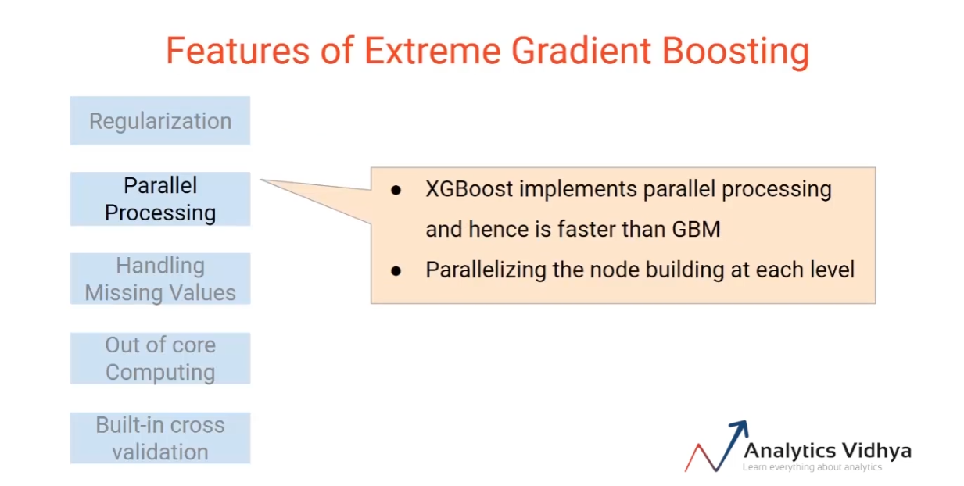

Slide 20
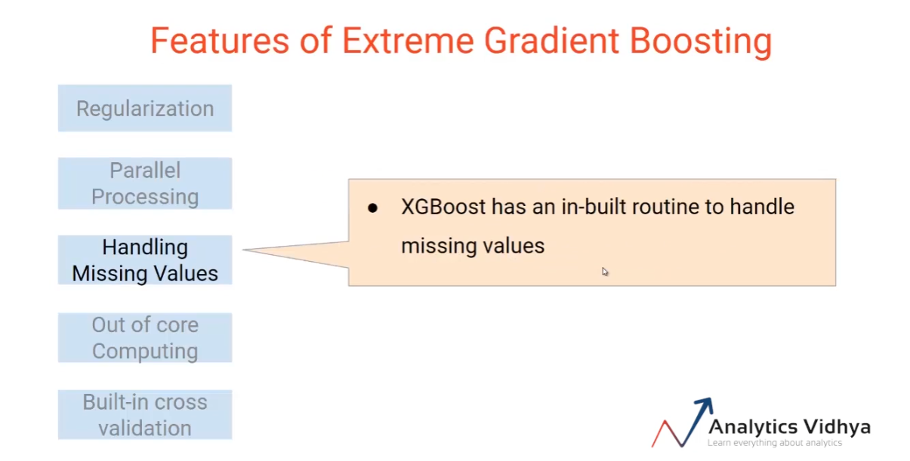

Slide 21
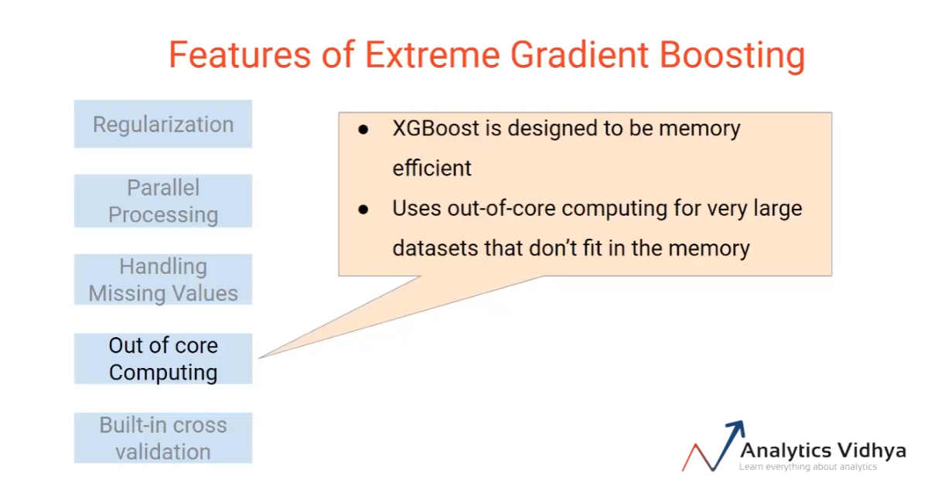

Slide 22
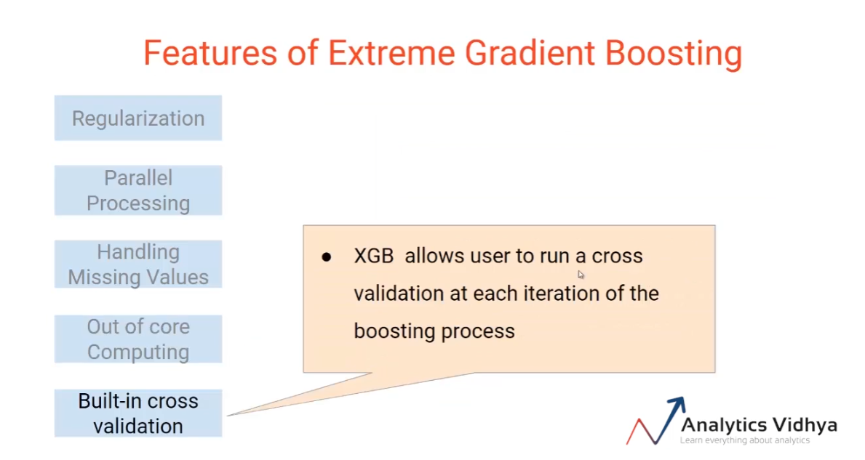

Slide 23
Demo
Code

Slide 24
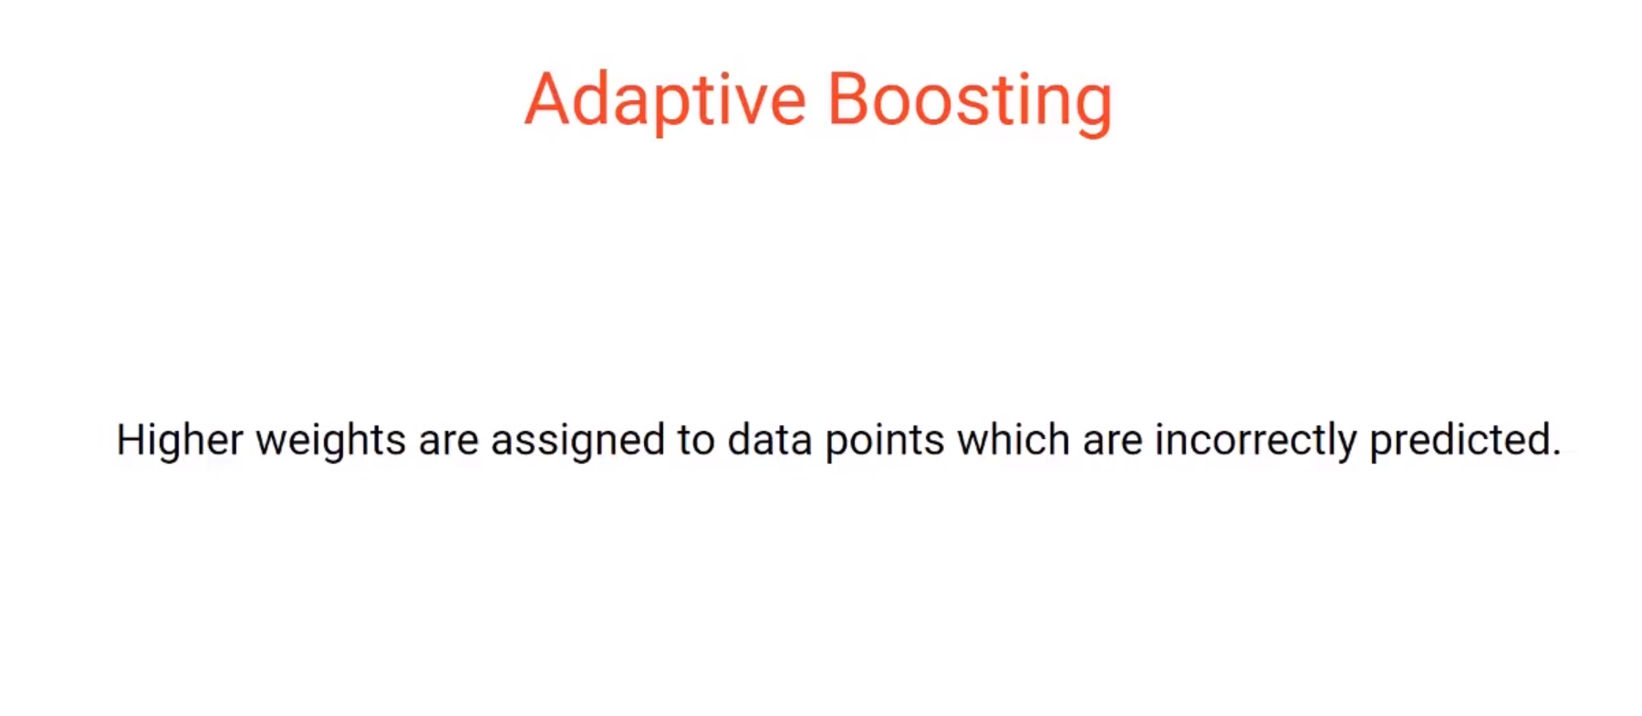

Slide 25
AdaBoost or Adaptive Boosting is one of the ensemble boosting classifier proposed by Yoav Freund and Robert Schapire in 1996.
It combines multiple weak classifiers to increase the accuracy of classifiers.
AdaBoost is an iterative ensemble method. AdaBoost classifier builds a strong classifier by combining multiple poorly performing classifiers so that you will get high accuracy strong classifier.

Slide 26
The basic concept behind Adaboost is to set the weights of classifiers and training the data sample in each iteration such that it ensures the accurate predictions of unusual observations.
Any machine learning algorithm can be used as base classifier if it accepts weights on the training set.

Slide 27
steps for performing the AdaBoost algorithm:
Initially, all observations are given equal weights.
A model is built on a subset of data.
Using this model, predictions are made on the whole dataset.
Errors are calculated by comparing the predictions and actual values.
While creating the next model, higher weights are given to the data points which were predicted incorrectly.
Weights can be determined using the error value. For instance,the higher the error the more is the weight assigned to the observation.
This process is repeated until the error function does not change, or the maximum limit of the number of estimators is reached.

Slide 28
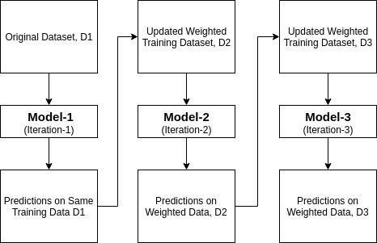

Slide 29
AdaBoost was designed in such a way that at every step the sample distribution was adapted to put more weight on misclassified samples and less weight on correctly classified samples. The final prediction is a weighted average of all the weak learners, where more weight is placed on stronger learners.

Slide 30
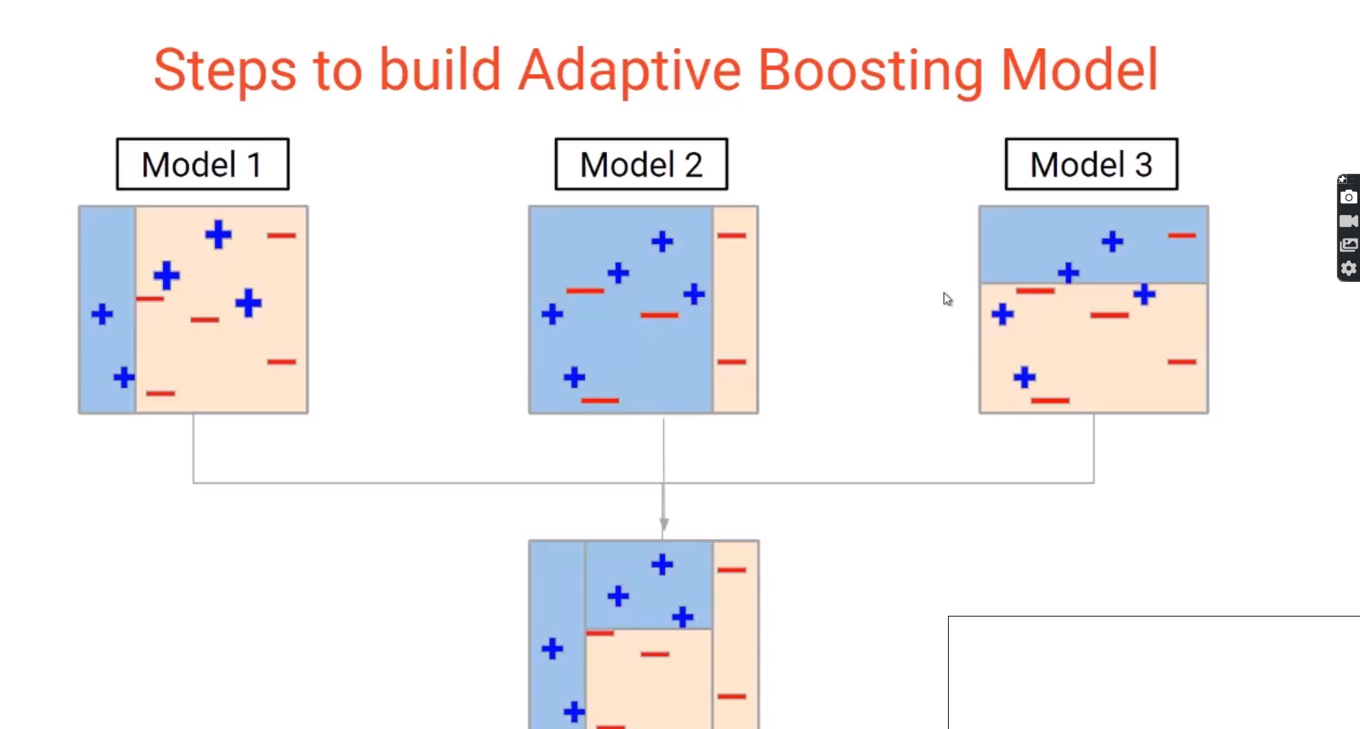
Adaptive Boosting

Slide 31
Difference btw GBM and Adaboost
The main difference therefore is that Gradient Boosting is a generic algorithm to find approximate solutions to the additive modeling problem, while AdaBoost can be seen as a special case with a particular loss function (Exponential loss function). Hence, gradient boosting is much more flexible.
AdaBoost can be interepted from a much more intuitive perspective and can be implemented without the reference to gradients by reweighting the training samples based on classifications from previous learners.
In Adaboost, shortcomings are identified by high-weight data points while in Gradient Boosting, shortcomings of existing weak learners are identified by gradients.
Adaboost is more about ‘voting weights’ and Gradient boosting is more about ‘adding gradient optimization’.
Adaboost increases the accuracy by giving more weightage to the target which is misclassified by the model. At each iteration, Adaptive boosting algorithm changes the sample distribution by modifying the weights attached to each of the instances. It increases the weights of the wrongly predicted instances and decreases the ones of the correctly predicted instances.

